Slide 1

Construction of Combinational Circuits
A Combinational Circuits consist of logic gates whose outputs at any instant of time are determined directly from the present combination of inputs without regard to previous input.
Ex: Adder, Subtractor, Converter, and Encoder/Decoder.

Slide 2
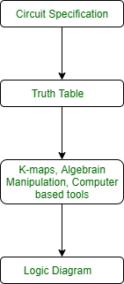
Analysis and Design
To design a combinational circuits, the procedure involves following steps:
Find the required number of inputs and outputs and assign a symbol to each.
Derive the truth table according to given specifications and function.
Using the truth table, obtain simplified Boolean functions for each output as a function of the input variables.
Draw the logic circuit diagram.

Slide 3
To obtain the output Boolean functions from a logic diagram, the procedure involves the following steps:
Label all gate outputs with unique symbols.
Find the Boolean functions for these gates.
To obtain the truth table directly from the logic diagram, the procedure involves the following steps:
Determine the number of input variables in the circuit.
Draw the table for these inputs. There are 2^{n} combinations for the n input variables (0 to (2^{n -1})).
Label the outputs with unique symbols for gates in the circuit.
Obtain the outputs of these gates in the table.

Slide 4
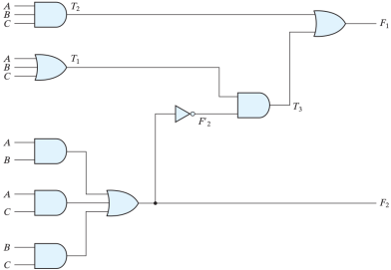
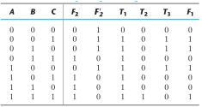
Analysis Pro
F1 = T3 + T2
= ∑(1,2,4,7)

Slide 5
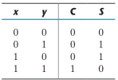
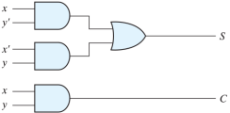

Binary Adder
Half Adder
S = xy’ + x’y
C = xy
S = x⊕y
C = xy

Slide 6
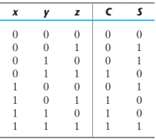
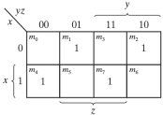
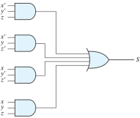
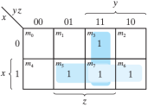
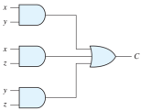
Full Adder
S = x’y’z + x’yz’ + xy’z’ + xyz
C = xy + xz + yz

Slide 7
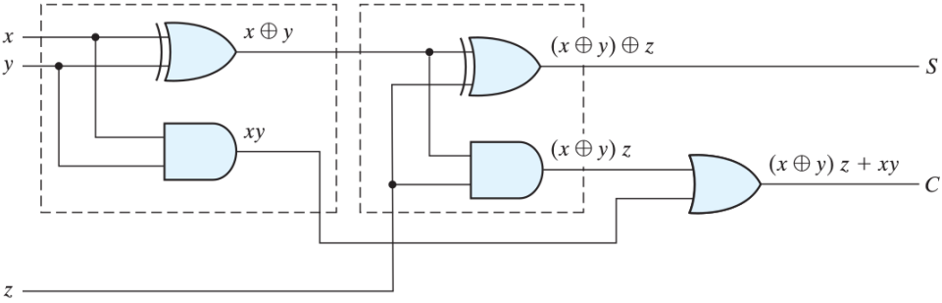
Implementing FA using only HA

Slide 8
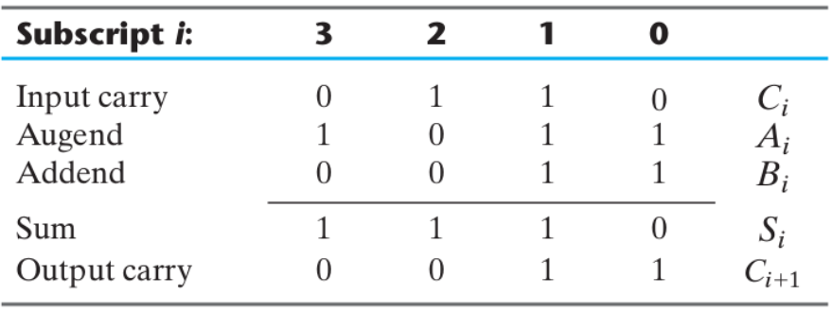
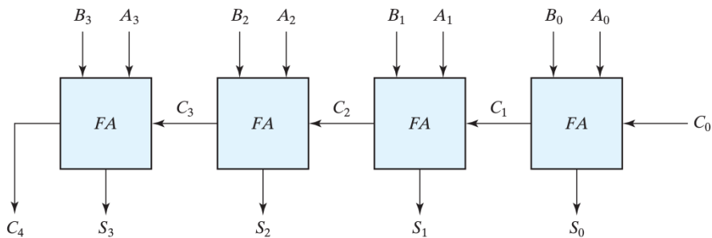
4-bit Binary Adder

Slide 9
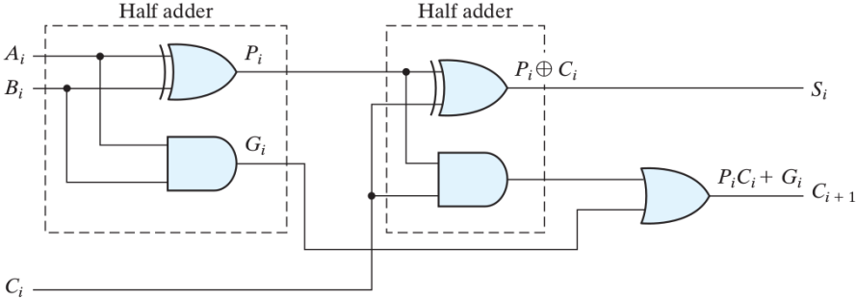
Carry Propagation

Slide 10
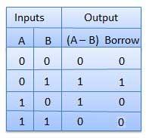
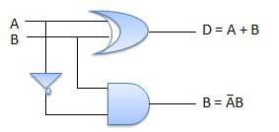
Binary Subtractor
Half Subtractor

Slide 11
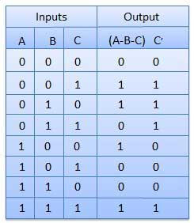
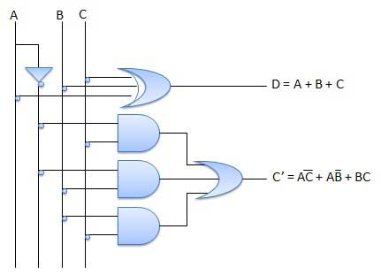
- Full Subtractor

Slide 12
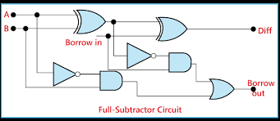

Slide 13

Decoder
A decoder is a circuit which has n inputs and 2^{n} outputs, and outputs 1 on the wire corresponding to the binary number represented by the inputs.
Ex: 2-1 decoder
d0 = i1’ i0’
d1 = i1’i0
d2
each of the d outputs corresponds to one of the four minterms.

Slide 14
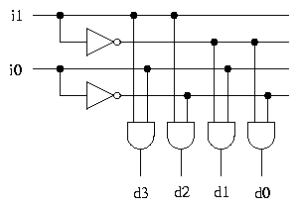
The following circuit generates all four minterms from two inputs, and implements the 2-4 decoder.

Slide 15

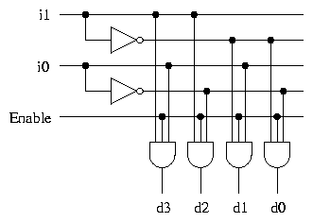
Decoder with Enable
Output is only generated when the Enable input has value 1;
otherwise, all outputs are 0.
Only a small change in the implementation is required:
the Enable input is fed into the AND gates which produce the outputs.

Slide 16
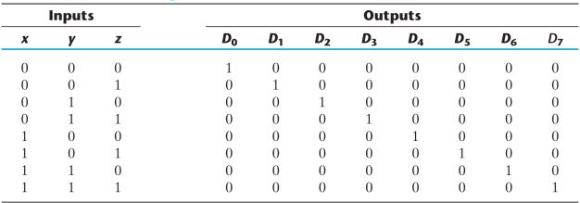
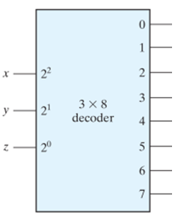
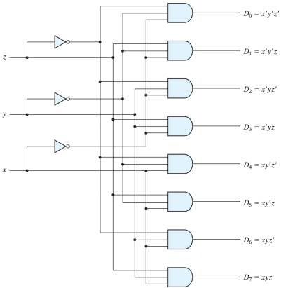
n X 2^{n} Decoder

Slide 17
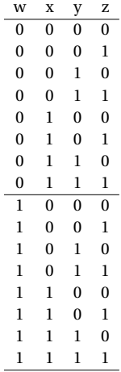
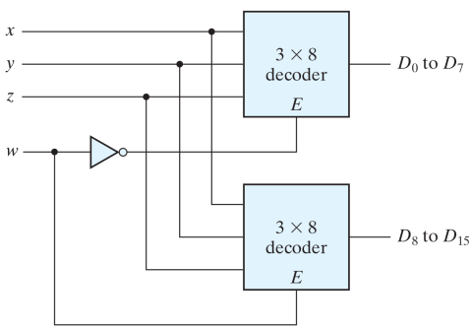
Design a 4x16 decoder using only 3x8 decoders.

Slide 18
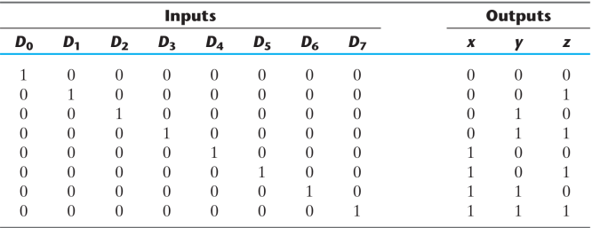
2^{n} X n Encoder

Slide 19
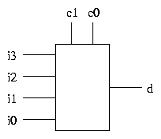
Muliplexer
A multiplexer is a device which allows one of a number of inputs to be routed to a single output. Here is a 4-1 multiplexer.
The control inputs c₀ and c₁ represent a 2-bit binary number, which determines which of the inputs i₀-i₃ is connected to the output d.
If c₁c₀ represents the number n in binary, then the value of the output d is the value of input i_{n}

Slide 20

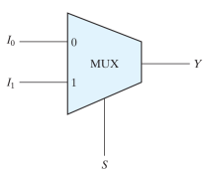
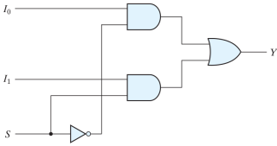
Multiplexers: 2^{n} X 1
Two-to-one-line Mux
Y = S’.I₀ + S.I₁

Slide 21
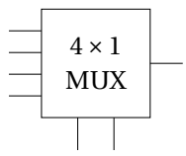
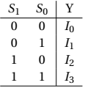
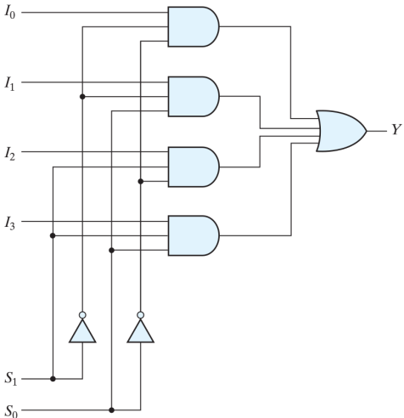
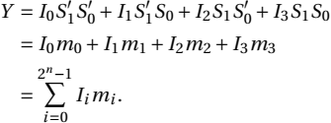
Four-to-one line Mux

Slide 22

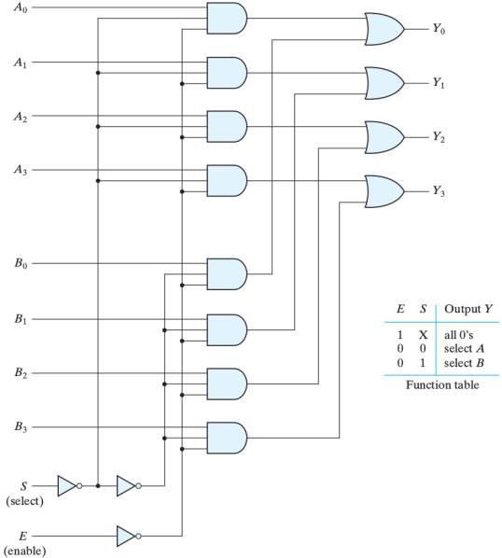
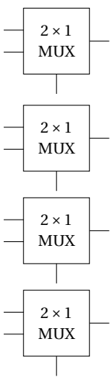
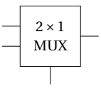
Quardable two-to-one line Mux
Design 1:
Design2: use four 2 x1 Mux

Slide 23
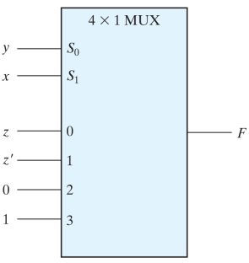
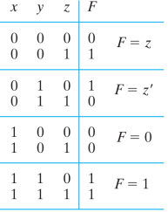
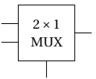
Boolean Function Implementation
Given: F(x,y,z) = ∑(1,2,6,7)
Implement it using 4x1 Mux
Use 2x1 Mux?
For x = 0
F = I₁ = yz’ + yz = y
For x = 1
F = I₀ = y’z + yz’

Slide 24
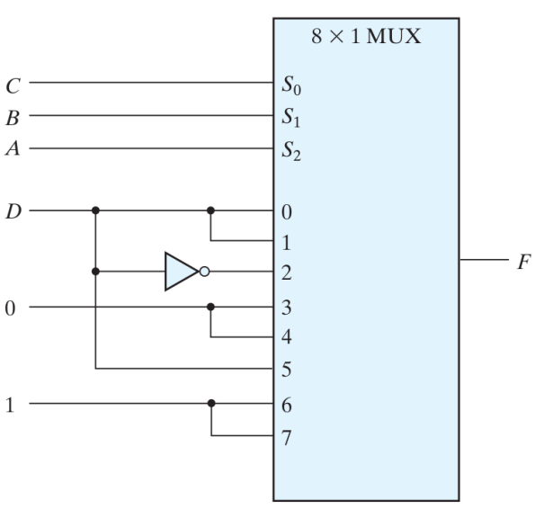
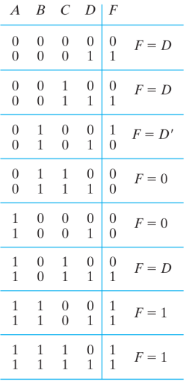
Implement F(A,B,C,D) = ∑(1,3,4,11,12,13,14,15) using 8x1 Mux

Slide 25
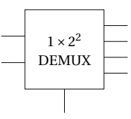
Demultiplexers (DEMUX)
1 x 2^{n}
Only the output F_{i} = I when selectors have a minterm value of i
F_{i} = I m_{i}
1 x 2^{n} DEMUX is nothing but Enabled n x 2^{n} DEC,
where the “Enable” is the input

